Slide 1

Epidemiology and Open Science: Moving forward
Michiel de Boer
Notes:
Question I like to answer is what is our role. Are we as special as we always think or should we just follow where things are going.

Slide 2
Proposition 1
Epidemiologist have a ‘special’ responsibility when it comes to Open Science

Slide 3
The role of Epidemiologists in the Open Science reform
Epidemiologists as analysts
Epidemiologists as change agents

Slide 4
Core of epidemiology
Firm focus on methods
Advocacy for high quality, robust research
Early initiatives related to Open Science:
Cochrane collaboration
Equator network
Meta-epidemiological research on (publication) bias
Notes:
Aangeven dat het veld dus vooral gericht is op transparancy, scrutiny, critique and reproducibility
Vragen: wie voelt zich (ook) verbonden met 1 van de andere principes in zijn/haar werk?

Slide 5
Proposition 2
Epidemiologists have been complacent in the Open Science era
Notes:
Misschien met dia 7 beginnen beginnen en dan naar de unesco toe

Slide 6
Open Science
“Open Science increases scientific collaborations and sharing of information for the benefits of science and society”
Unesco: https://doi.org/10.54677/MNMH8546 (CC-BY-SA 3.0 IGO)
Notes:
Aangeven dat het veld dus vooral gericht is op transparancy, scrutiny, critique and reproducibility
Vragen: wie voelt zich (ook) verbonden met 1 van de andere principes in zijn/haar werk?

Slide 7
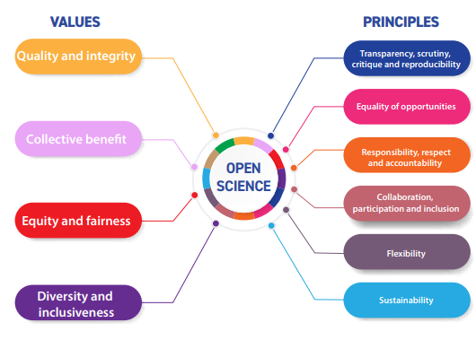
OS: values and principles
Notes:
Aangeven dat het veld dus vooral gericht is op transparancy, scrutiny, critique and reproducibility
Vragen: wie voelt zich (ook) verbonden met 1 van de andere principes in zijn/haar werk?

Slide 8
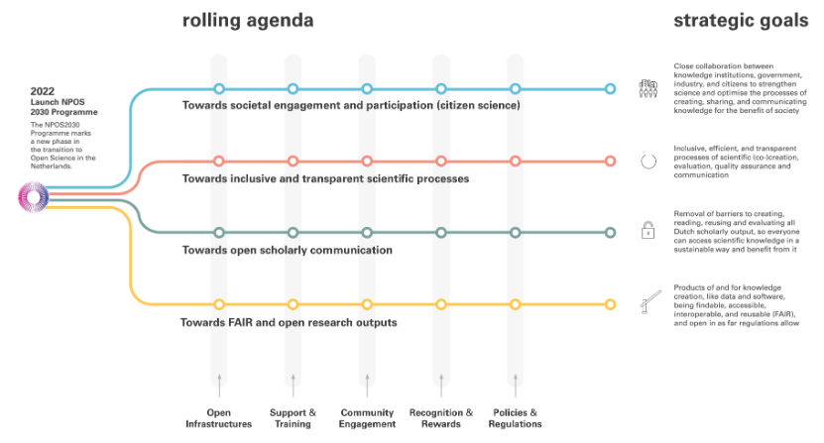
National Program on Open Science

Slide 9
Proposition 3
Epidemiologist should spend more time replicating findings and less on ‘novel’ research
Notes:
Misschien met dia 7 beginnen beginnen en dan naar de unesco toe

Slide 10
Epidemiologists as analysts
Understanding the replication crisis

Slide 11
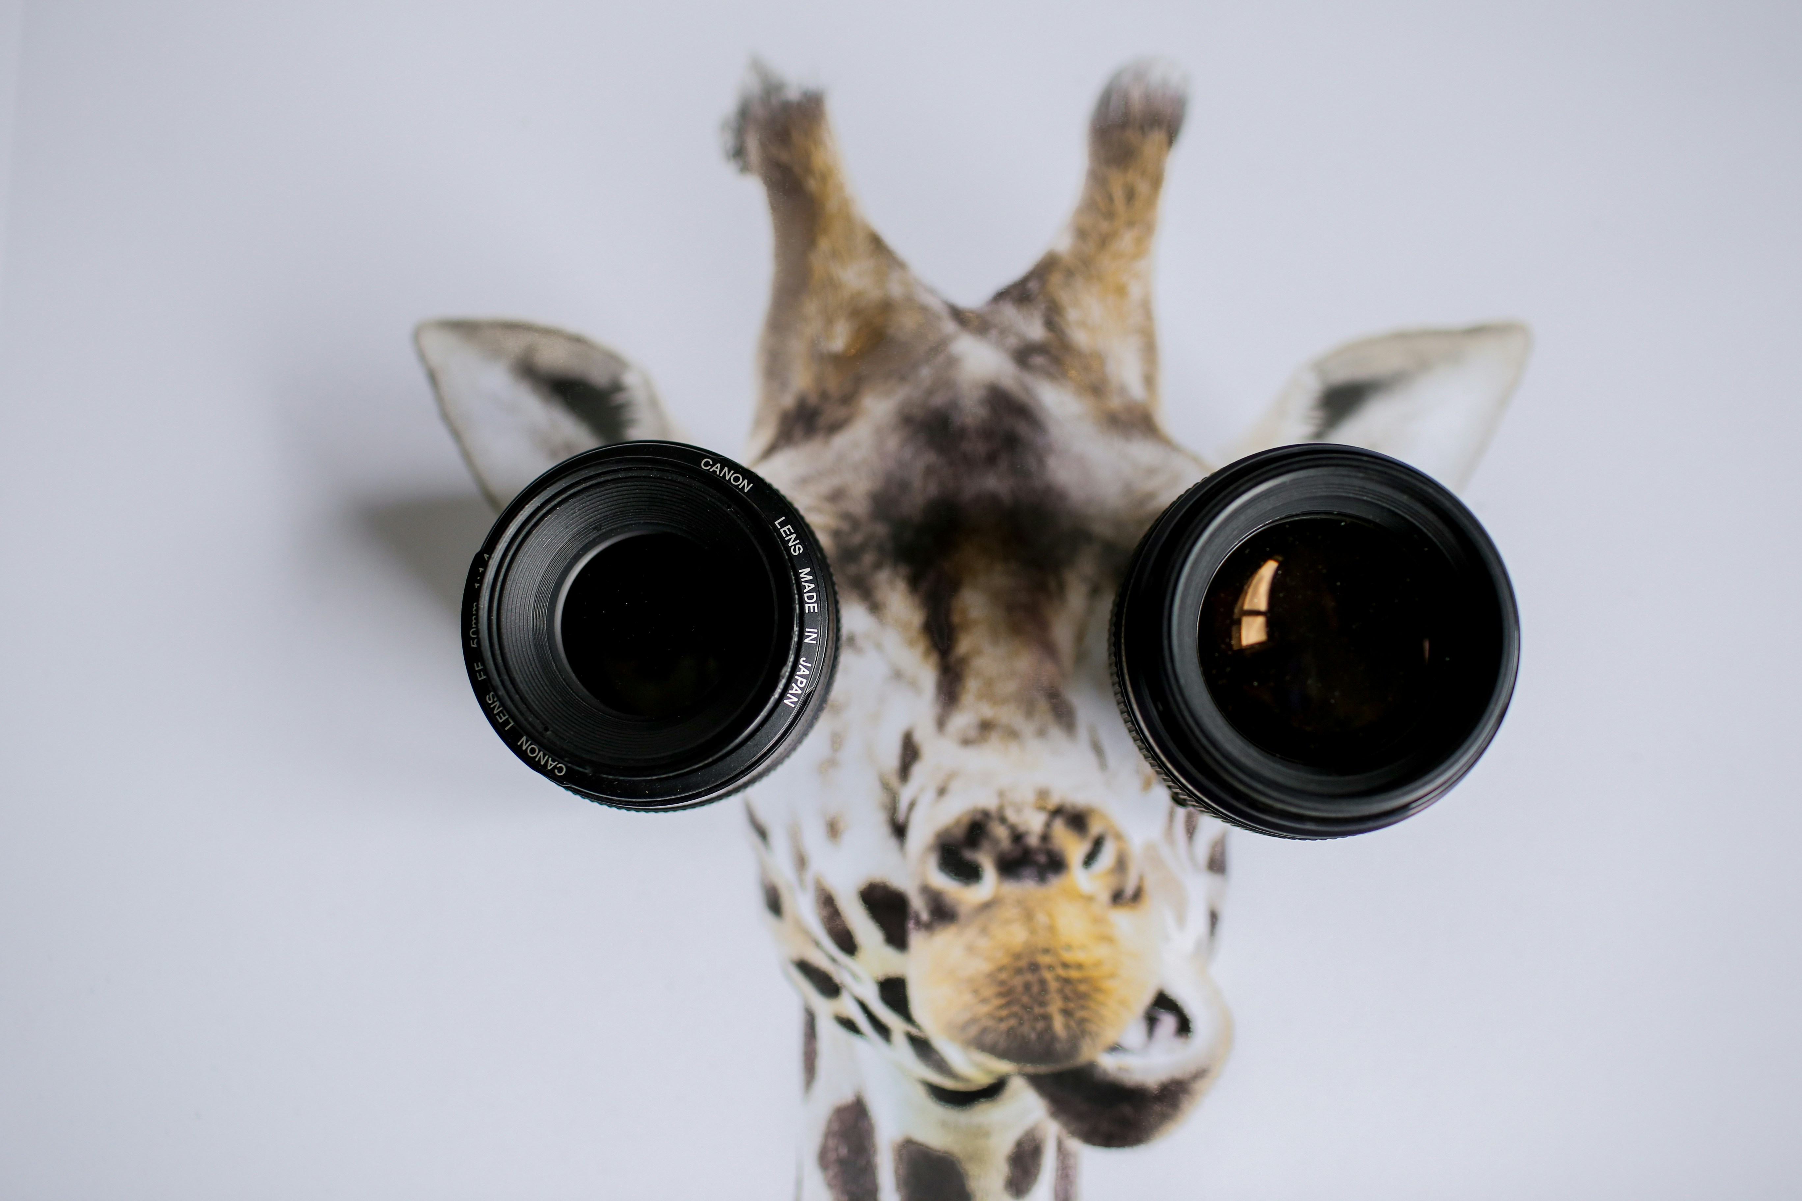
Reasons for the ‘replication crisis’ from an epidemiological lens
Reliability / Precision
(Internal) validity: Selection bias, information bias, confounding
Generalizabilty – effect modification
Photo by James Bold on Unsplash

Slide 12
Precision
Type I and type II errors in combination with publication bias and selective reporting
Has been shown that this can lead to replication rates similar to those found in the literature

Slide 13
Replication studies precision and publication bias
Original studies
 | Ha true | H0 true
P<0.05 | 50 | 50 | 100
p≥0.05 | 50 | 950 | 1000
 | 100 | 1000 | 1100

Slide 14
Replication studies precision and publication bias
Original studies
Replication studies
 | Ha true | H0 true
P<0.05 | 50 | 50 | 100
p≥0.05 | 50 | 950 | 1000
 | 100 | 1000 | 1100
 | Ha true | H0 true
P<0.05 | 40 | 5 | 45
p≥0.05 | 10 | 45 | 55
 | 50 | 50 | 100
Typical power: 50%
Alpha = 5%
Expected replication rate = 45 / 100 = 45%
Observed non-significant findings lower because of publication bias and selective reporting

Slide 15
Precision
Type I and type II errors in combination with publication bias and selective reporting
Has been shown that this can lead to replication rates similar to those found in the literature
Replication of effectsizes (estimates)
Use prediction intervals to estimate replicability
Estimated replication rate Psychology Reproducibility Project: 70%

Slide 16
(Internal) validity
A succesful replication does not guarantee validity of the original and replication studies
Non-replication can be caused by differences in ‘selection’ , ‘measurement’ and ‘confounding’ between original and replication study

Slide 17
(Internal) validity
Selection: most focus has been on ‘differential’ attrition
Measurement: most focus has been on differential ‘operationalizations’ or ‘manipulations’ (referred to as construct validity)
Confounding: hardly mentioned in the literature, but possible problems
Differential adjustment
Different confounders relevant over time

Slide 18
Generalizability
Central question: What is the domain of interest / the PICO / the estimand?
Can that be assumed the same for original and replication study?
Identification of possible effectmodifiers (boundary conditions), between study settings over time, e.g.:
Severity or staging of disease
Age
Treatment modalities or frequencies
Health care system
Treatment expectations of patients
…..

Slide 19
Summary
We have some evidence that precision, validity and generalizability all contribute to replication rates
We are slowly learning what works to improve things
Majority of research performed in Psychology

Slide 20
Epidemiologists as analysts
Some champions
Most Open Science meta-science performed by social and behavioral scientists
Epidemiologists should/could collaborate more with other disciplines and include other methodologies and epistemologies

Slide 21
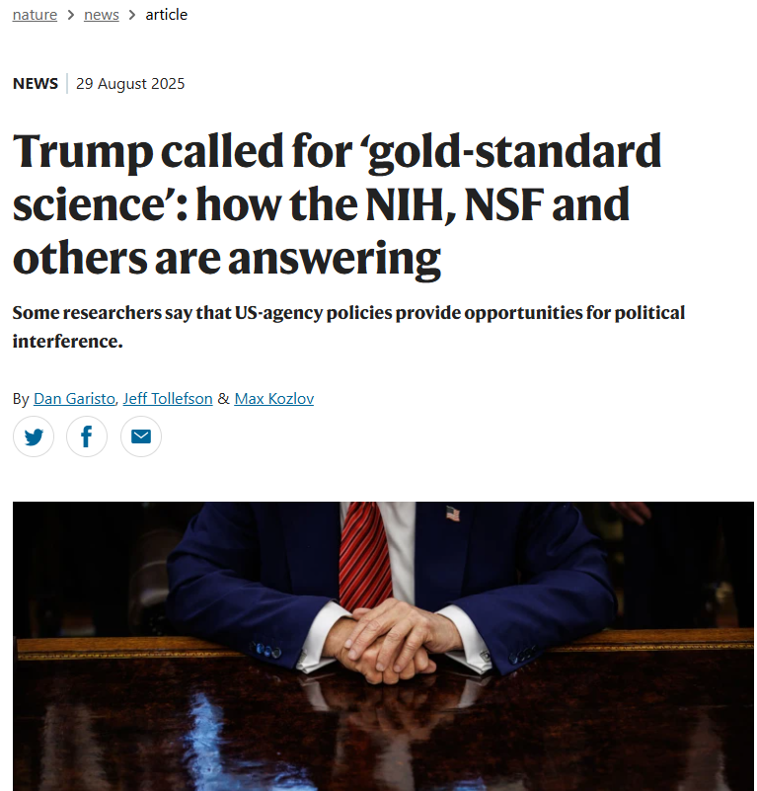
Epidemiologists as change agents
“The overall strategy is attacking scientific findings in order to diminish the public’s trust,” says David Michaels, an epidemiologist at George Washington University in Washington DC who held public-health positions under previous administrations.
https://www-nature-com.proxy-ub.rug.nl/articles/d41586-025-02770-w

Slide 22
Proposition 4
Epidemiologists should be Open Science activists

Slide 23
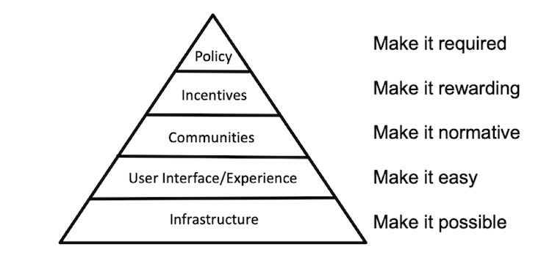
Pyramid of Nosek

Slide 24
Open Science

Slide 25
Training & support
Epidemiology programs: work openly and transparently throughout the program, e.g. using open source software and reproducible code
Supervisors: encourage and reward OS practices from your trainees or at least be ‘open’ to these practices
Epidemiology trainees: challenge your supervisors when necessary
Epidemiological Association: Do registration requirements fit with Open Science norms?

Slide 26
Community engagement
Epidemiologists (in training):
Share and discuss practices within research groups, departments and institutions
Become involved in Open Science Communities
If possible: organise events on OS practices
Epidemiological Association: organise events

Slide 27
Recognition and rewards
Supervisors/senior epidemiologists: lobby for or influence directly policy related o recognition and rewards of OS practices
Epidemiologists in training: influence policy through e.g. PhD committees
Epidemiological Society: recognize OS practices in registration requirements

Slide 28
Policy and regulations
All stakeholders: lobby for obligation to perform (certain) OS practices

Slide 29
Conclusion
Given our focus on methodological quality of research, epidemiologist can and should step up in OS reform movement
Contribute more to meta-science / meta epidemiological studies
Act as change agents where we can, supporting those OS practices with a firm evidence base

