Slide 1


EHDS : steeplechase?
Olenka van Ardenne, Nov 17, 2025
[]

Slide 2
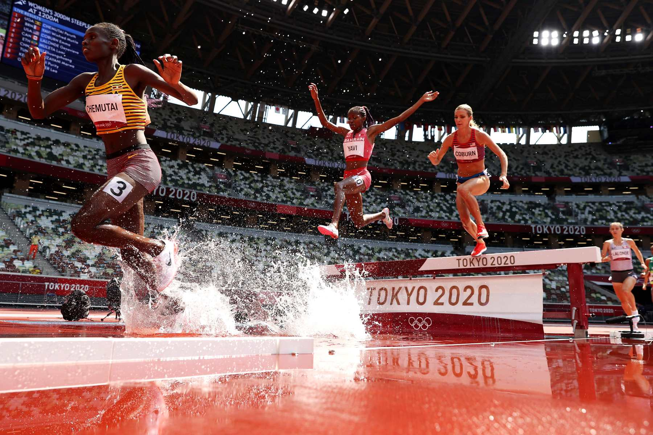
Introduction and presentation flow
Interactive topics
Jumped forward and or hurdles?
Timeline
Ground work: definitions data and data sets
Stepwise approach permit
Ethics
GDPR
Costs, IP

Slide 3
EHDS enacted! Effective gradually, preparation
2024
2025
2026
2027
2028
2029
2030
2031+
EHDS effective (2 years after enactment
Primary use
-Patient files
- Elektronic prescriptions
- Elektronic provision
Primary use
-images
- Testresuls
Final/ Dismiss reports
Partial revision EHDS (8 jaar after enactment
Work on implementation acts
EHR systems and MyHealthData@EU
Legislative instrument effective HealthData@EU
In werking
Third countries may align, reciprocity secundary use (10 year after )
Secundary use
- files
- Aggregated
- Pathogen
- Administrative
- Medical device
- Wellness app
- Health professionals
- Registraties
- Biobanks
Secundairy use
- Exposome
- Human genetic
- Omics
- Clinical trials
- Cohort studies
Implementation act adopted HealthData@EU
aangenomen
Revision EHDS(10 +)

Slide 4
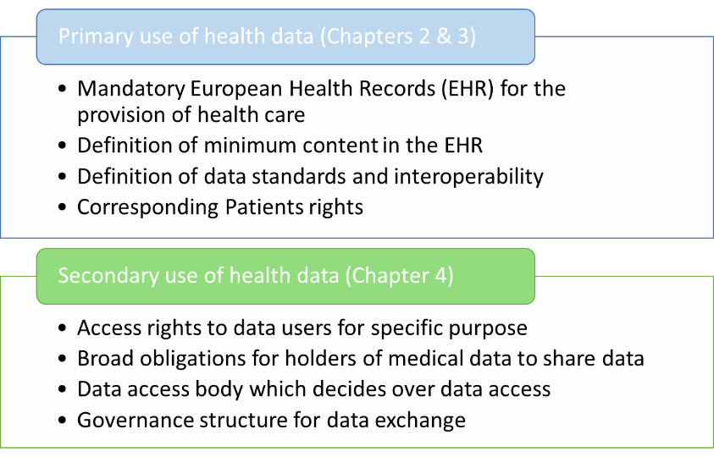
Primair vs Secundary use

Slide 5
Secundary use: data catalogue, data set, data, non personal health data
26.03.2027: EC impl act: minimum elements HDH to provide data sets, EC Data set catalogue, national Data Set catalogue
Data Set=structured collection of data
.
Data (set) holders provide data sets and characteristiscs
Health Data Access Body:
on website
Non personal healthdata=a) anonymized or b) never has been personal data

Slide 6
Secundary use: Application and data flow 3+3 (if needed)+0+??+2 in SPE(unless)
Data set Catalogue,quality and utility label ?
1.
Application, detailed information intended use, ethical assessment template 2027 67)
2.Request to HDH
Health Data User
(Applicant,
Health Data Access Body
SPE
Health Data Holder
Adequate, relevant,and limited to what is necessary, may bring own data in SPE
Download non personal data

Slide 7
Secundary use: Application and data flowTrusted Health Data Holder
Application, detailed information intended use, ethical assessment template 2027 67)
Request data.
Health Data User
(Applicant,
Health Data Access Body
Trusted Health Data Holder (optional national law), SPE
Adequate, relevant,and limited to what is necessary, may bring own data in SPE

Slide 8
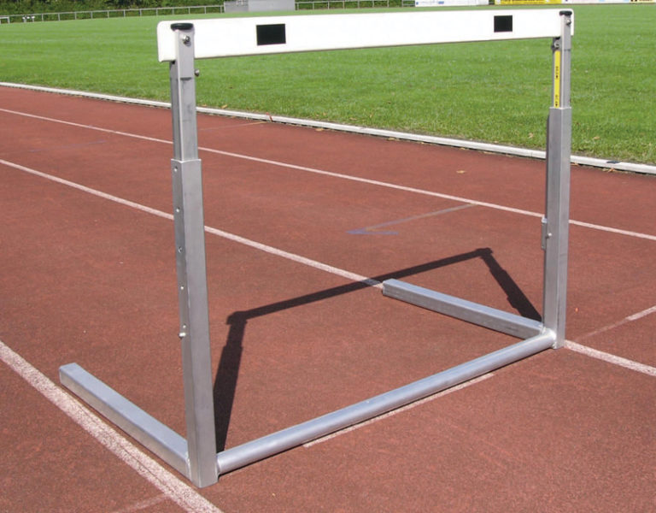

EHDS – Ethical aspects: hurdle? Apple syrup? Or fluently national
- Data Application permit:
- HDAB ethical assessment (national legislation)
- In application information on assessment of ethical aspects of the processing required under national law.
nWMO national law?, LHC a body?
November 7, 2025

Slide 9
EHDS – Ethical aspects: hurdle? Apple syrup? Or fluently international
- Data Application permit: ethical assessment HDAB
- HealthData@EU communication between national HDAB`s: process application
Further ethical assessment per state?
- Marginal ethical assessment in other Member States EU? Mutual recognition?
- 27 Member States committed to the same ethical treaties and values, WMA declaration etc
November 17, 2025

Slide 10
GDPR: applicable?
GDPR applies/parallel
Access data? Free of charge, immediate: note, within scope EHDS, regardless in which country the data are processed
Exemption: request could be harmful/unethical (patient does not know yet =delay possible etc)
National competences, genetic information, opt-out
Controllers: HDAB, for making available data available, processing data within its task, trusted data holder related to the provision of health data

Slide 11
Intellectual Property Rights
Patent
Data Protection Rights
Data bank
Trade Secrets
Confidentiality Agreements
Inform HDAB
Justify need protection
HDAB: proportionate measures
Legal, Organizational and technical measures, refuse

Slide 12
Suggestions, questions
Suggestions
Questions
Joint platform=joint data holder (efficient, costs?)
Trusted Data Holder (efficiency, costs)
IP rights (map, register, monitor)
Set up points to consider when initiating research, collaboration, parallel sytems
Never discuss costs with other entities

Slide 13
Olenka.vanardenne@lygature.org

