Slide 1




Preprints
Opportunities, policies, and what to look out for
Presented by:
Tessa de Roo, Digital Scholarship Librarian, Centre for Digital Scholarship
Leiden University Libraries and LUMC
t.f.de.roo@library.leidenuniv.nl
Open Access Team at Leiden University Libraries
openaccess@library.leidenuniv.nl

Slide 2
Preprinting as part of Open Access Publishing
What is a preprint
How does this fit into Open Access
Current state of preprinting
New policies
Getting started
National Preprint Guide
Preprint Opportunities
Find a preprint server to read and publish on
PRC models

Slide 3
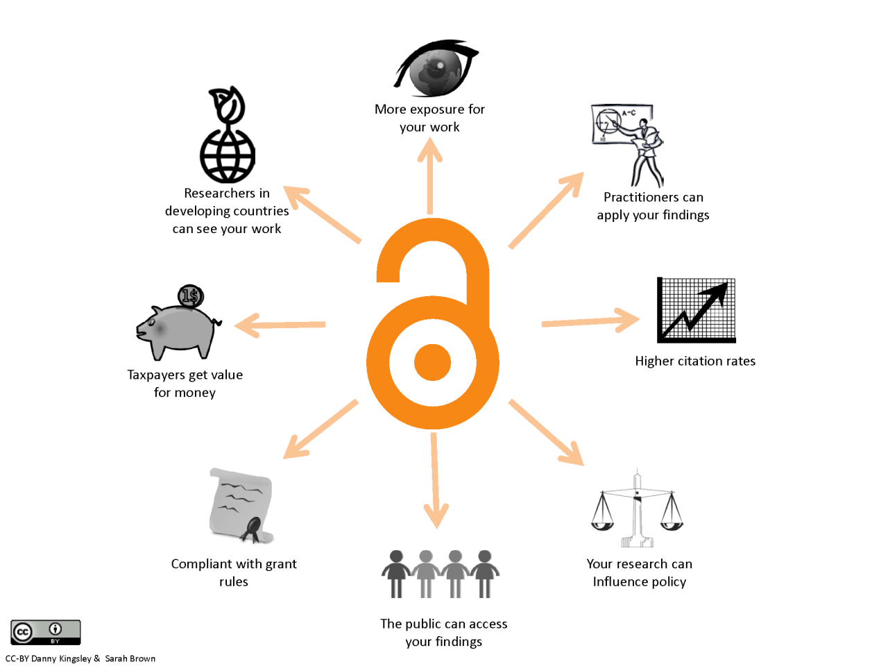
What is Open Access
Free and permanent access to scientific research combined with Clear guidelines (user licenses) for users to reuse the content.
Part of Open Science: “A more open and inclusive way of conducting, publishing and evaluating scientific research.”
www.openscience.nl

Slide 4
Wat is a preprint
A preprint is a research article that is made openly available on a preprint server, typically before submission to a peer-reviewed journal.
Preprinting enables new scientific knowledge to be shared in a timely and open way.
By preprinting their work, authors can prevent lengthy delays in the dissemination of their research, thereby contributing to speeding up progress in science.
The state of preprinting in Europe and the Netherlands
Leiden Madtrics Blog, 22 May 2025
Notes:
https://www.leidenmadtrics.nl/articles/the-state-of-preprinting-in-europe-and-the-netherlands#50611

Slide 5
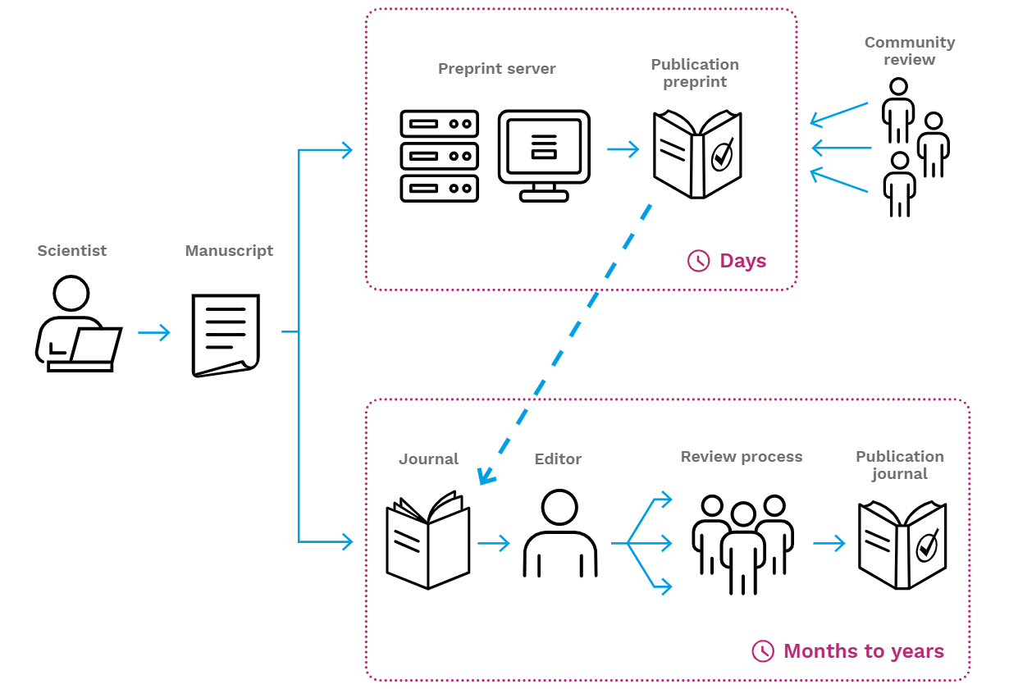
Preprinting in the publishing process
A Practical Guide to Preprints: Accelerating Scholarly Communication https://zenodo.org/records/5600535

Slide 6
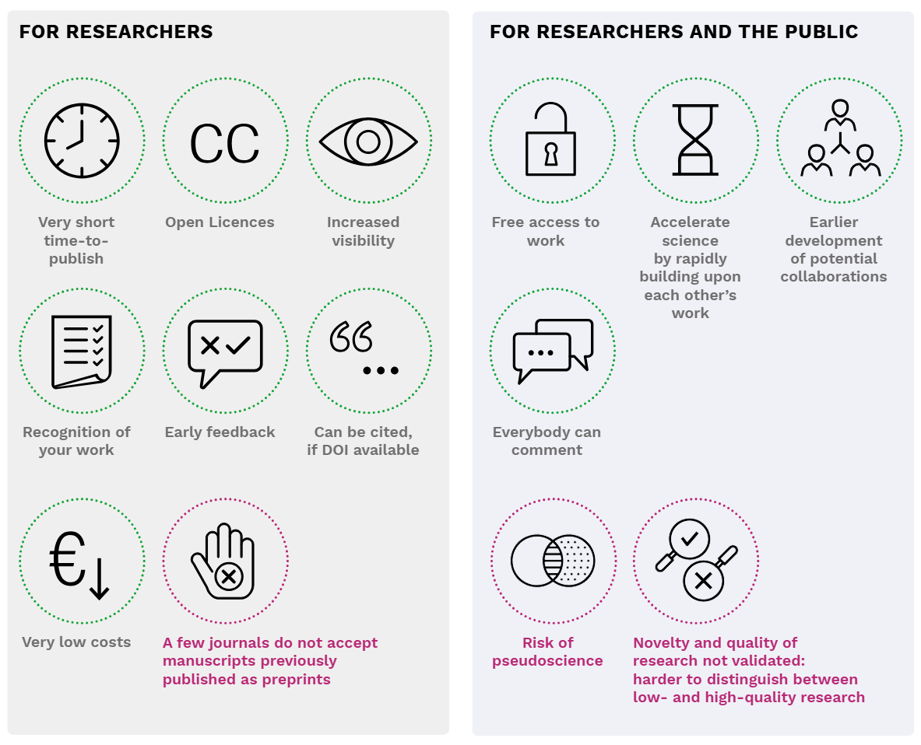
Pros and cons or preprinting
A Practical Guide to Preprints: Accelerating Scholarly Communication https://zenodo.org/records/5600535
Notes:
Use with caution (and awareness of UK rights retention) - https://openpolicyfinder.jisc.ac.uk/

Slide 7
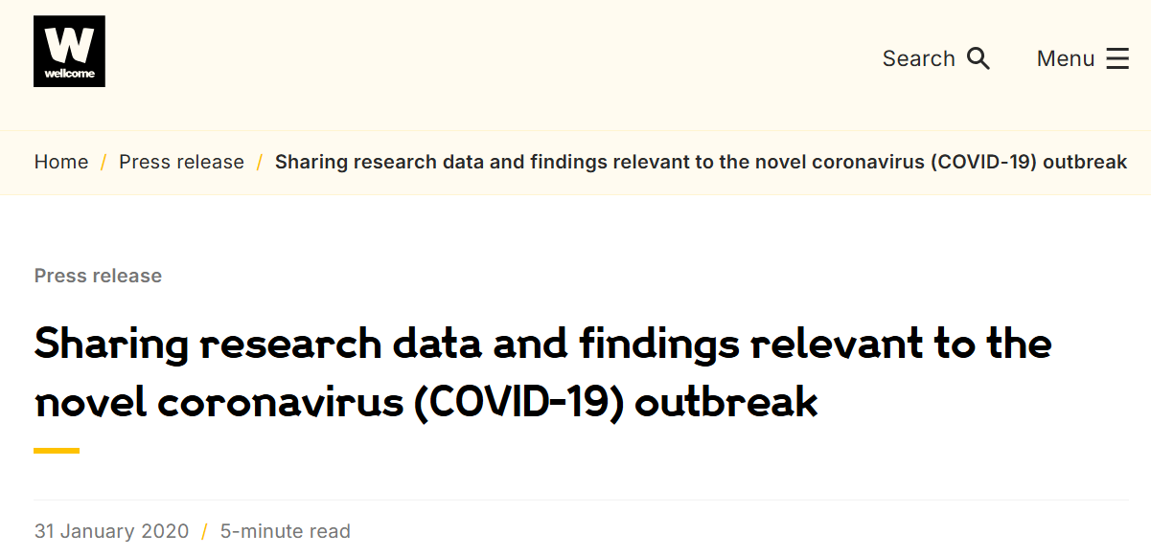
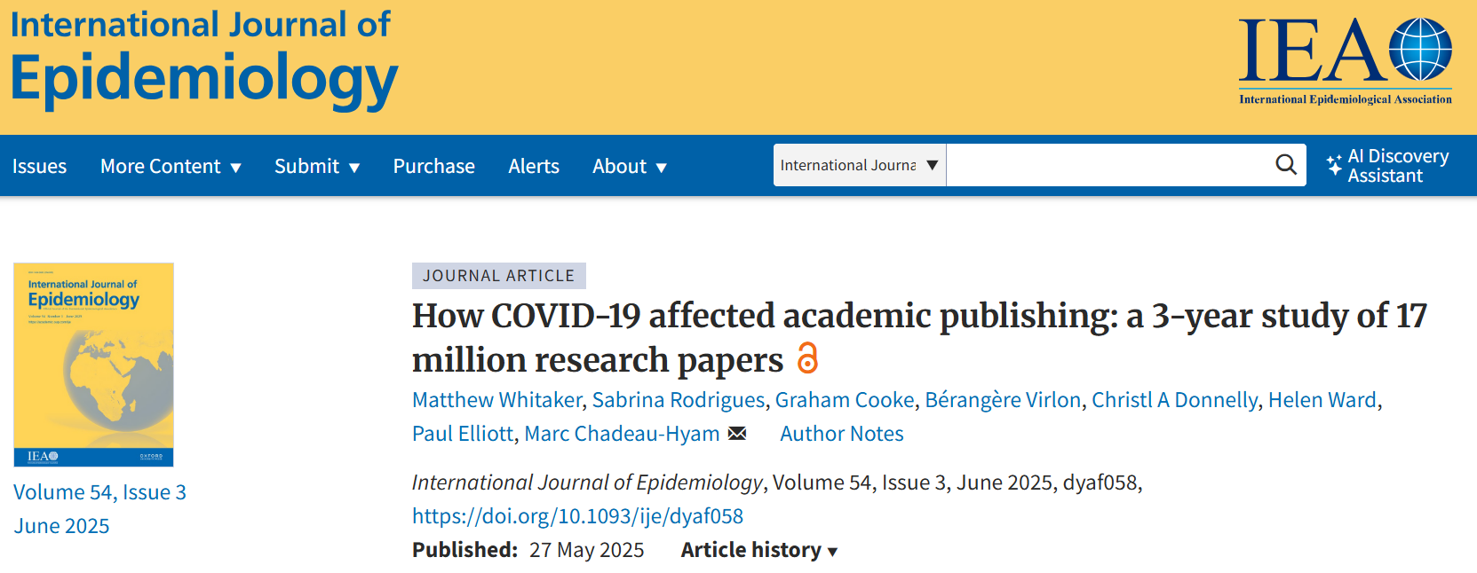
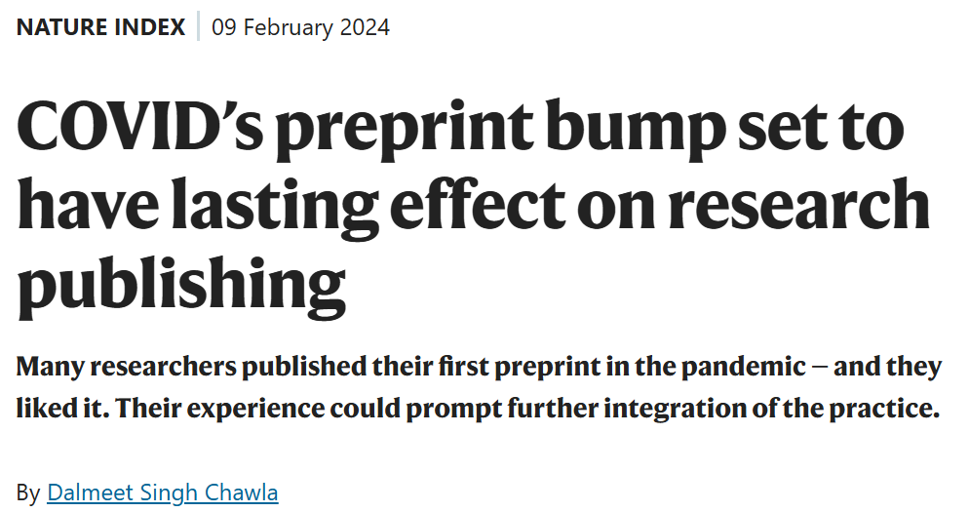
Development of preprint use
Notes:
Articles on speeding up of publishing via preprints:
https://wellcome.org/press-release/sharing-research-data-and-findings-relevant-novel-coronavirus-ncov-outbreak
Wellcome Trust urging for use of preprints at start of pandemic
https://www.nature.com/articles/d41586-024-00401-4
Positive experience for researchers
Majority go on to submit to traditional journals
AI will have increasing impact on use and evaluation of preprints
https://academic.oup.com/ije/article/54/3/dyaf058/8151272
“Preprints played an important role in disseminating scientific findings, but the level of coverage of preprinted findings emphasizes the need for guidelines in handling preprint research in media, particularly during a pandemic.”

Slide 8
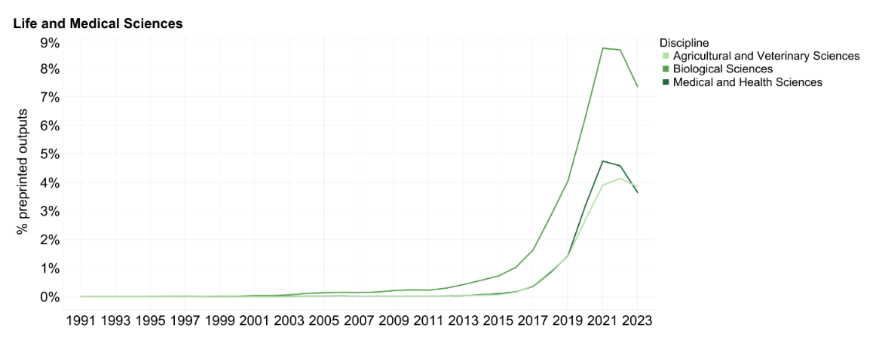
Development of preprint use
Example:
BioRxiv receives around 4000 new preprint submissions a month
MedRxiv receives around 1000 new preprint submissions a month
Together, the repositories draw more than 11 million monthly readers.
https://www.nature.com/articles/d41586-025-00762-4
Comparison:
PLOS ONE receives around 3000 submissions a month in all fields
https://everyone.plos.org/2022/04/25/publication-timeframes-at-plos-one/
Proportion of peer-reviewed outputs with a link to a preprint up to 2023. https://osf.io/preprints/socarxiv/xdwc4_v2
Notes:
https://www.leidenmadtrics.nl/articles/the-state-of-preprinting-in-europe-and-the-netherlands
Adoption of Preprinting Across Scientific Disciplines and Geographical Regions (1991-2023)
https://osf.io/preprints/socarxiv/xdwc4_v2
https://www.nature.com/articles/d41586-025-00762-4
BioRxiv receives around 4000 new preprint submissions a month
MedRxiv receives around 1000 new preprint submissions a month
Together, the repositories draw more than 11 million monthly readers.
Comparison:
(PLOS ONE receives about 3000 submissions a month in all fields https://everyone.plos.org/2022/04/25/publication-timeframes-at-plos-one/ )

Slide 9
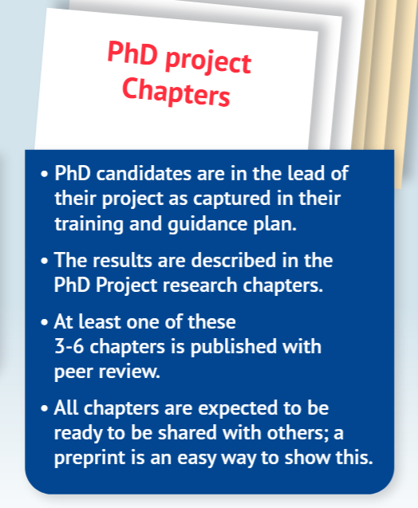
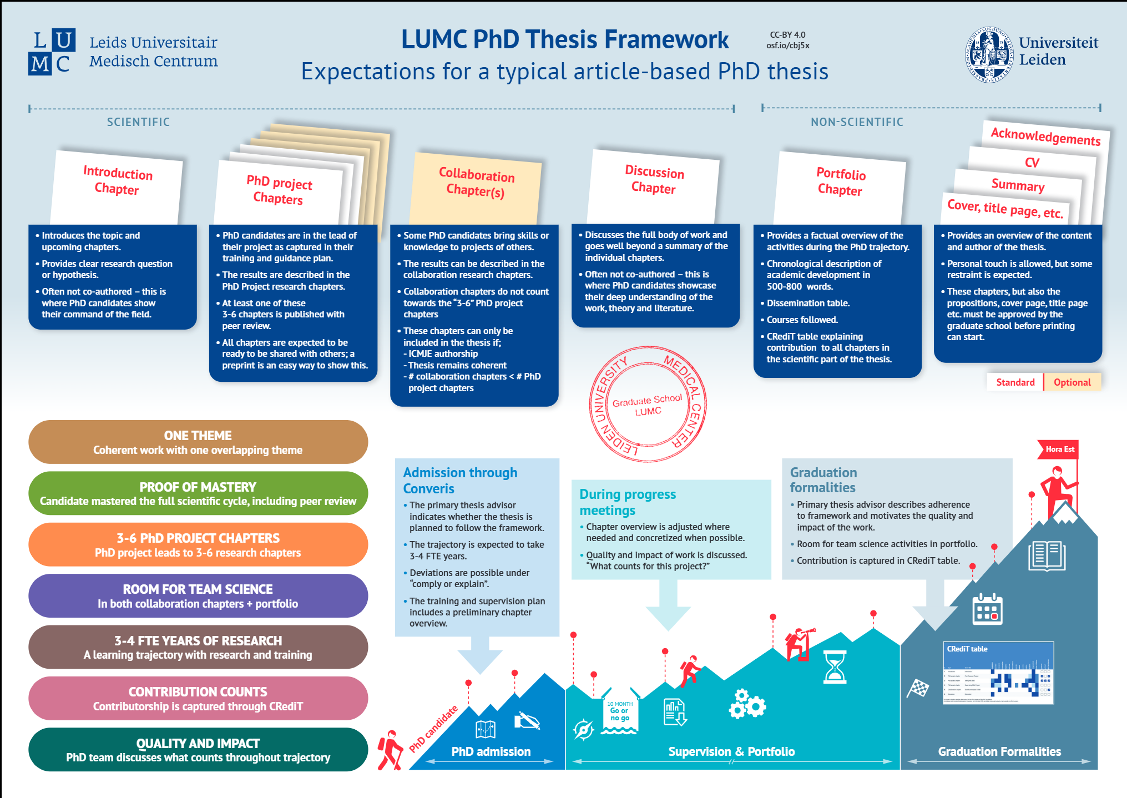
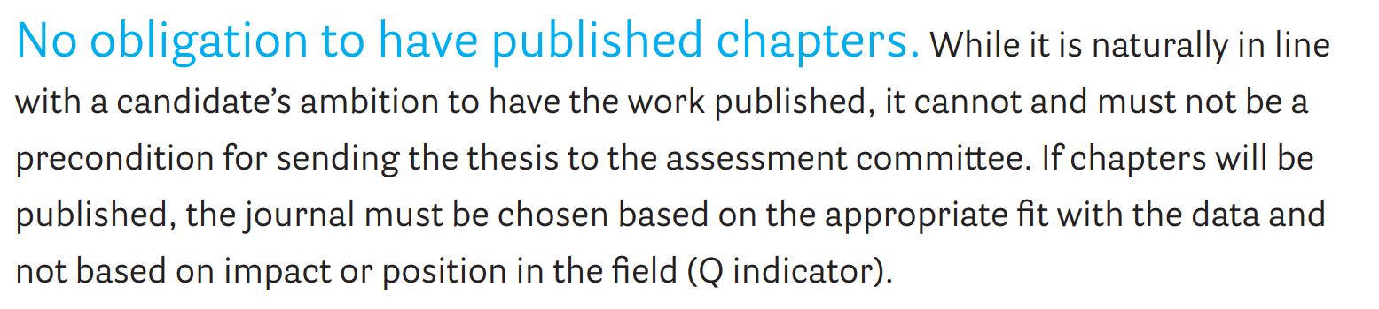
New institutional policies
Notes:
LUMC PhD Thesis Framework
https://osf.io/cbj5x/files/yspza
UMCG PhD Policy 2025
https://www.rug.nl/research/gradschool-medical-sciences/prospective-phd-candidates/phd-thesis-requirements-eng-v-oktober.pdf

Slide 10
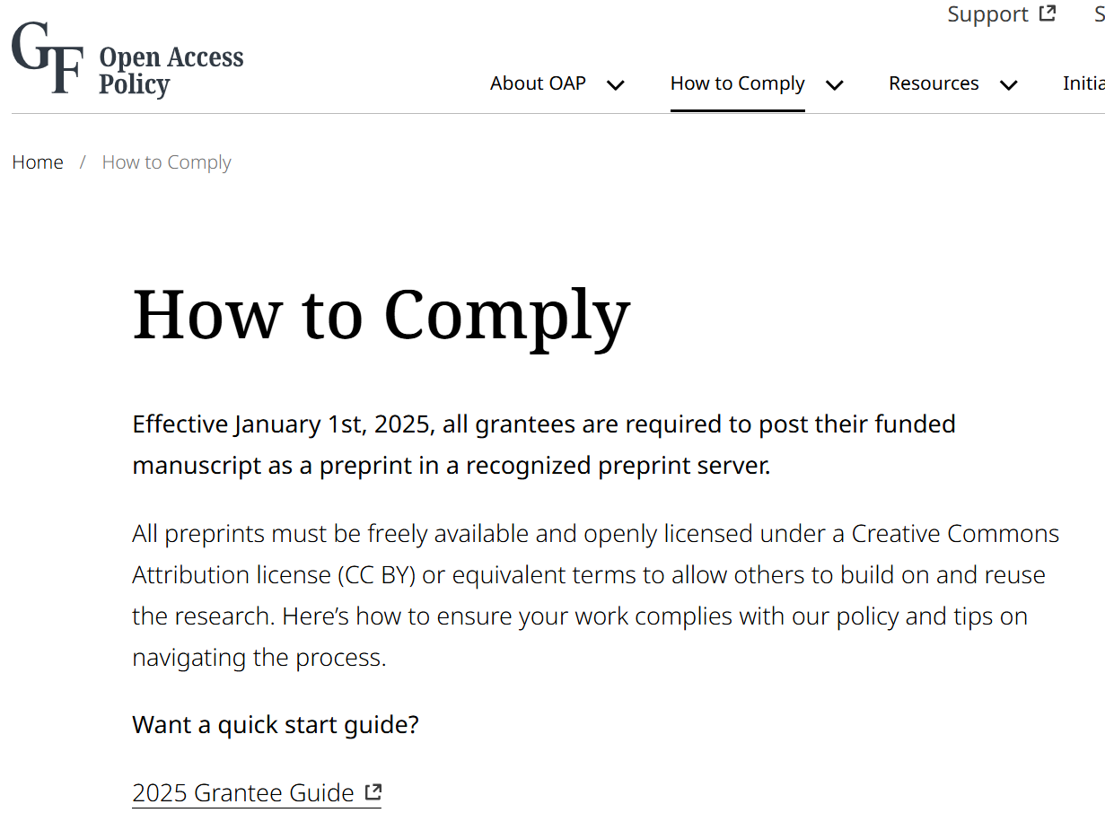
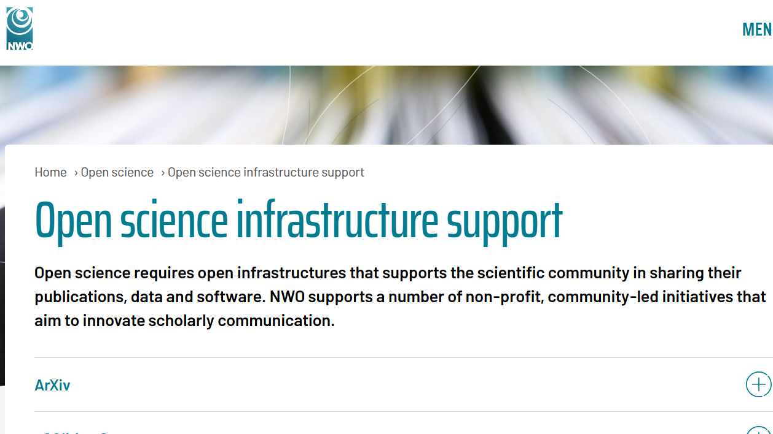
New funder policies
Notes:
Gates Foundation Policy https://openaccess.gatesfoundation.org/how-to-comply/
NWO and ZonMw supports preprinting but do not yet require it

Slide 11
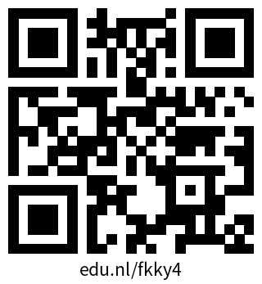
Getting started with preprinting
National guide on preprints
A Practical Guide to Preprints: Accelerating Scholarly Communication https://zenodo.org/records/5600535
Other guides on publishing and open science
https://zenodo.org/communities/wgoaguides

Slide 12
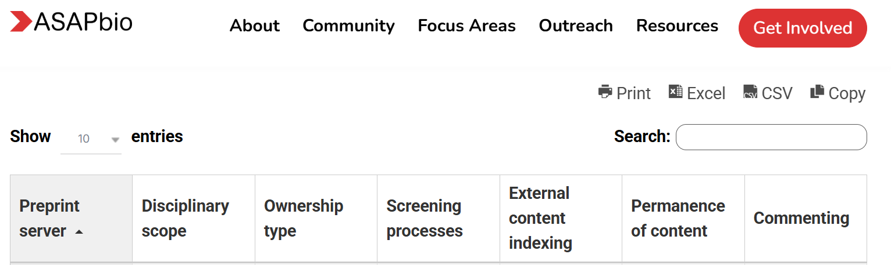
How do you find preprint servers?
Similar to journals: Where do your colleagues publish?
Common servers used in the Netherlands include arXiv, bioRxiv, medRxiv, chemRxiv, SSRN, Research Square…
ASAPbio Overview of preprint platforms and policies:
https://asapbio.org/preprint-servers/

Slide 13
How do you find preprint servers?
Considerations when choosing a preprint server:
Target audience
Server features
Persistent identifiers
Licences offered
Commenting
Possibilities for open review (or PRC)
Indexation in search engines
Version control and updating possibilities
Linking to peer reviewed articles
Before posting a preprint:
Get consent from all authors
Check policies of potential journals for later peer reviewed publication
Share data and code
Decide what licence is best for the preprint
For next steps →→ Use the Preprint Guide!

Slide 14
How do you find preprints?
Specific
Search on specific preprint platforms
e.g. arXiv, bioRxiv, medRxiv, chemRxiv, SSRN, Research Square…
Scholarly/medical
Scopus, Web of Science
EuropePMC
PubMed, PubMed Central (PMC)
Dimensions
OSF preprints
General
Google Scholar and other major search engines

Slide 15
Publish-Review-Curate (PRC)
“Publish-Review-Curate(PRC) is a model of scientific communication that breaks the process of publishing down into distinct parts.”
A detailed introduction and overview from ASAPbio: https://edu.nl/wwamp
Publish: The article/preprint is made public by the author on a platform.
Review: Reviewers openly provide feedback on the article/preprint.
Curate: Reviewed articles are may be gathered into collections, may have badges of approval, evaluations, or other summaries applied to them. Articles may move on to become traditional journal publications.
PRC platform examples
eLife https://elifesciences.org/
Peer Community In https://peercommunityin.org/
PREreview https://prereview.org/
Notes:
https://asapbio.org/understanding-the-publish-review-curate-prc-model-of-scholarly-communication/
“Article” used here to mean published unit

Slide 16
A more open publishing model
What can you do to support more open science communication?
Publish openly
Review openly
(Re)Use open materials in research, presentations, and teaching

Slide 17
Recap: Preprinting as part of Open Access Publishing
What is a preprint
How does this fit into open access
Current state of preprinting
Pros and cons of preprinting
Publisher policies
New policies addressing preprinting
(LUMC, UMCG)
Getting started
Practical Guide to Preprints
Preprint opportunities
Find a preprint server to read and publish on
https://asapbio.org/preprint-servers/
PRC models

Slide 18
More information
Preprints
Dutch national publishing guides (preprinting, copyright, predatory publishing, etc.): https://zenodo.org/communities/wgoaguides/
ASAPbio preprint directory https://asapbio.org/preprint-servers/
Open Science and Open Publishing
Dutch national OA information and OA Journal Browser www.openaccess.nl
Open Science NL www.openscience.nl
DOAJ [Directory of Open Access Journals] https://doaj.org
Leiden Madtrics Blog https://www.leidenmadtrics.nl/

